Slide 1
Chapter 2
Process Models
Slide Set to accompany
Software Engineering: A Practitioner’s Approach, 7/e
by Roger S. Pressman
Slides copyright © 1996, 2001, 2005, 2009 by Roger S. Pressman
For non-profit educational use only
May be reproduced ONLY for student use at the university level when used in conjunction with Software Engineering: A Practitioner's Approach, 7/e. Any other reproduction or use is prohibited without the express written permission of the author.
All copyright information MUST appear if these slides are posted on a website for student use.
These slides are designed to accompany Software Engineering: A Practitioner’s Approach, 7/e (McGraw-Hill, 2009). Slides copyright 2009 by Roger Pressman.

Slide 2
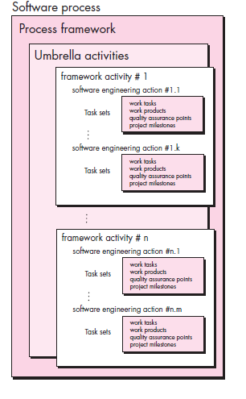
A Generic Process Model
These slides are designed to accompany Software Engineering: A Practitioner’s Approach, 7/e (McGraw-Hill, 2009). Slides copyright 2009 by Roger Pressman.

Slide 3
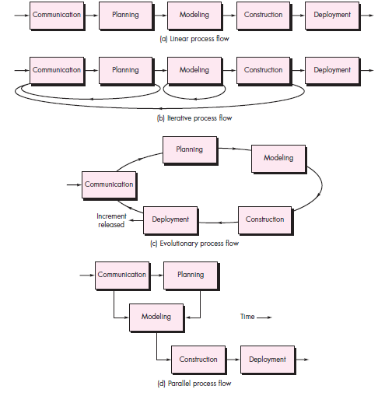
Process Flow
These slides are designed to accompany Software Engineering: A Practitioner’s Approach, 7/e (McGraw-Hill, 2009). Slides copyright 2009 by Roger Pressman.

Slide 4
Identifying a Task Set
A task set defines the actual work to be done to accomplish the objectives of a software engineering action.
  A list of the task to be accomplished
  A list of the work products to be produced
  A list of the quality assurance filters to be applied
These slides are designed to accompany Software Engineering: A Practitioner’s Approach, 7/e (McGraw-Hill, 2009). Slides copyright 2009 by Roger Pressman.

Slide 5
Process Patterns
A process pattern
  describes a process-related problem that is encountered during software engineering work,
  identifies the environment in which the problem has been encountered, and
  suggests one or more proven solutions to the problem.
Stated in more general terms, a process pattern provides you with a template [Amb98]—a consistent method for describing problem solutions within the context of the software process.
These slides are designed to accompany Software Engineering: A Practitioner’s Approach, 7/e (McGraw-Hill, 2009). Slides copyright 2009 by Roger Pressman.

Slide 6
Process Pattern Types
Stage patterns—defines a problem associated with a framework activity for the process.
Task patterns—defines a problem associated with a software engineering action or work task and relevant to successful software engineering practice
Phase patterns—define the sequence of framework activities that occur with the process, even when the overall flow of activities is iterative in nature.
These slides are designed to accompany Software Engineering: A Practitioner’s Approach, 7/e (McGraw-Hill, 2009). Slides copyright 2009 by Roger Pressman.

Slide 7
Process Assessment and Improvement
Standard CMMI Assessment Method for Process Improvement (SCAMPI) — provides a five step process assessment model that incorporates five phases: initiating, diagnosing, establishing, acting and learning.
CMM-Based Appraisal for Internal Process Improvement (CBA IPI)—provides a diagnostic technique for assessing the relative maturity of a software organization; uses the SEI CMM as the basis for the assessment [Dun01]
SPICE—The SPICE (ISO/IEC15504) standard defines a set of requirements for software process assessment. The intent of the standard is to assist organizations in developing an objective evaluation of the efficacy of any defined software process. [ISO08]
ISO 9001:2000 for Software—a generic standard that applies to any organization that wants to improve the overall quality of the products, systems, or services that it provides. Therefore, the standard is directly applicable to software organizations and companies. [Ant06]
These slides are designed to accompany Software Engineering: A Practitioner’s Approach, 7/e (McGraw-Hill, 2009). Slides copyright 2009 by Roger Pressman.

Slide 8
Prescriptive Models
Prescriptive process models advocate an orderly approach to software engineering
That leads to a few questions …
If prescriptive process models strive for structure and order, are they inappropriate for a software world that thrives on change?
Yet, if we reject traditional process models (and the order they imply) and replace them with something less structured, do we make it impossible to achieve coordination and coherence in software work?
These slides are designed to accompany Software Engineering: A Practitioner’s Approach, 7/e (McGraw-Hill, 2009). Slides copyright 2009 by Roger Pressman.

Slide 9
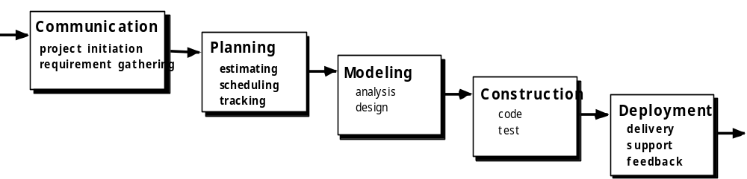
The Waterfall Model
These slides are designed to accompany Software Engineering: A Practitioner’s Approach, 7/e (McGraw-Hill, 2009). Slides copyright 2009 by Roger Pressman.

Slide 10

The V-Model
These slides are designed to accompany Software Engineering: A Practitioner’s Approach, 7/e (McGraw-Hill, 2009). Slides copyright 2009 by Roger Pressman.

Slide 11
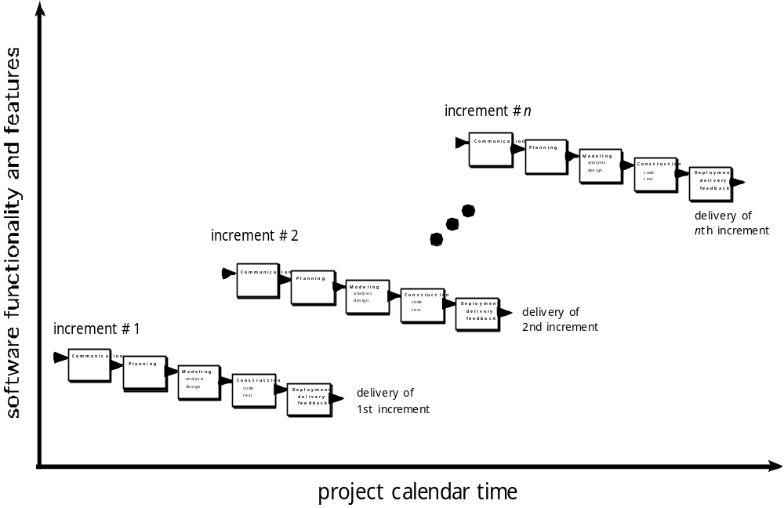
The Incremental Model
These slides are designed to accompany Software Engineering: A Practitioner’s Approach, 7/e (McGraw-Hill, 2009). Slides copyright 2009 by Roger Pressman.

Slide 12

Evolutionary Models: Prototyping
Quick
plan
communication
Modeling
Quick design
Deployment
delivery &
feedback
Construction
of prototype
Construction
of prototype
These slides are designed to accompany Software Engineering: A Practitioner’s Approach, 7/e (McGraw-Hill, 2009). Slides copyright 2009 by Roger Pressman.

Slide 13
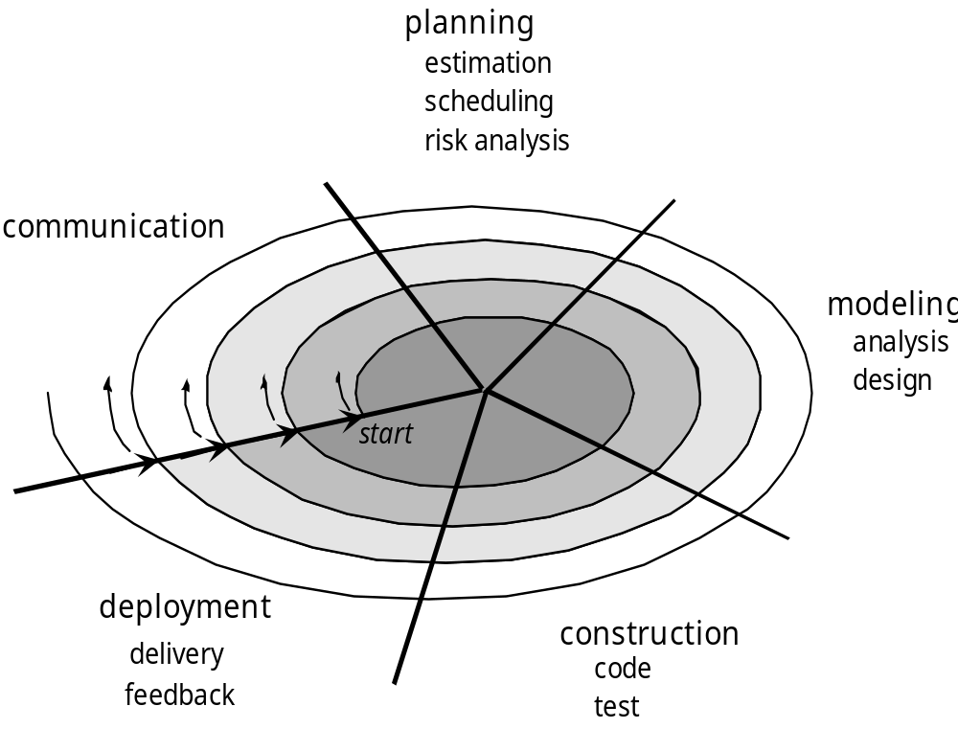
Evolutionary Models: The Spiral
These slides are designed to accompany Software Engineering: A Practitioner’s Approach, 7/e (McGraw-Hill, 2009). Slides copyright 2009 by Roger Pressman.

Slide 14
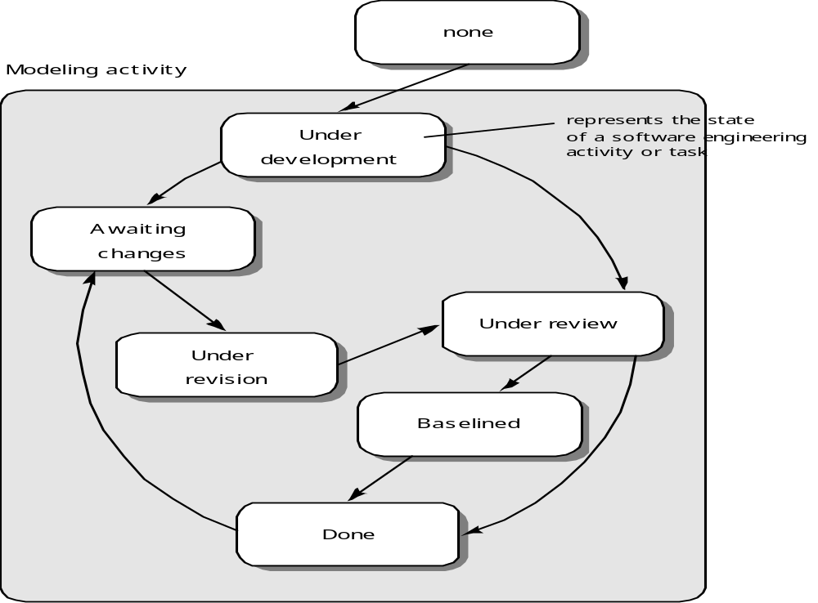
Evolutionary Models: Concurrent
These slides are designed to accompany Software Engineering: A Practitioner’s Approach, 7/e (McGraw-Hill, 2009). Slides copyright 2009 by Roger Pressman.

Slide 15
Still Other Process Models
Component based development—the process to apply when reuse is a development objective
Formal methods—emphasizes the mathematical specification of requirements
AOSD—provides a process and methodological approach for defining, specifying, designing, and constructing aspects
Unified Process—a “use-case driven, architecture-centric, iterative and incremental” software process closely aligned with the Unified Modeling Language (UML)
These slides are designed to accompany Software Engineering: A Practitioner’s Approach, 7/e (McGraw-Hill, 2009). Slides copyright 2009 by Roger Pressman.

Slide 16

The Unified Process (UP)
elaboration
inception
These slides are designed to accompany Software Engineering: A Practitioner’s Approach, 7/e (McGraw-Hill, 2009). Slides copyright 2009 by Roger Pressman.

Slide 17
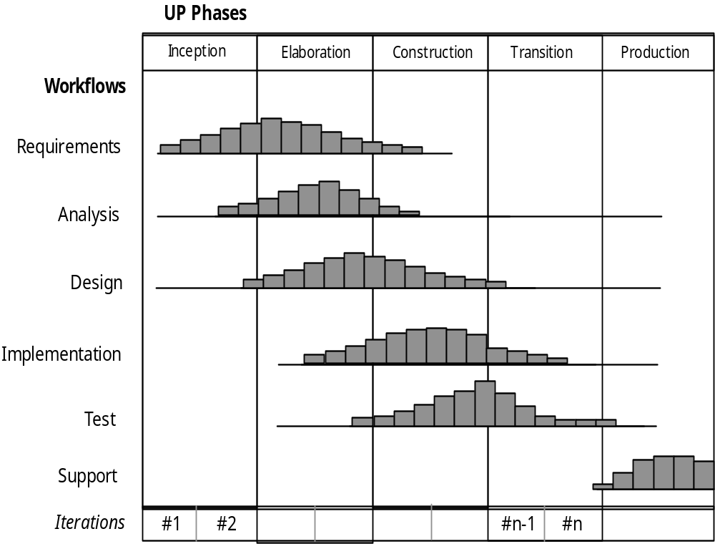
UP Phases
These slides are designed to accompany Software Engineering: A Practitioner’s Approach, 7/e (McGraw-Hill, 2009). Slides copyright 2009 by Roger Pressman.

Slide 18
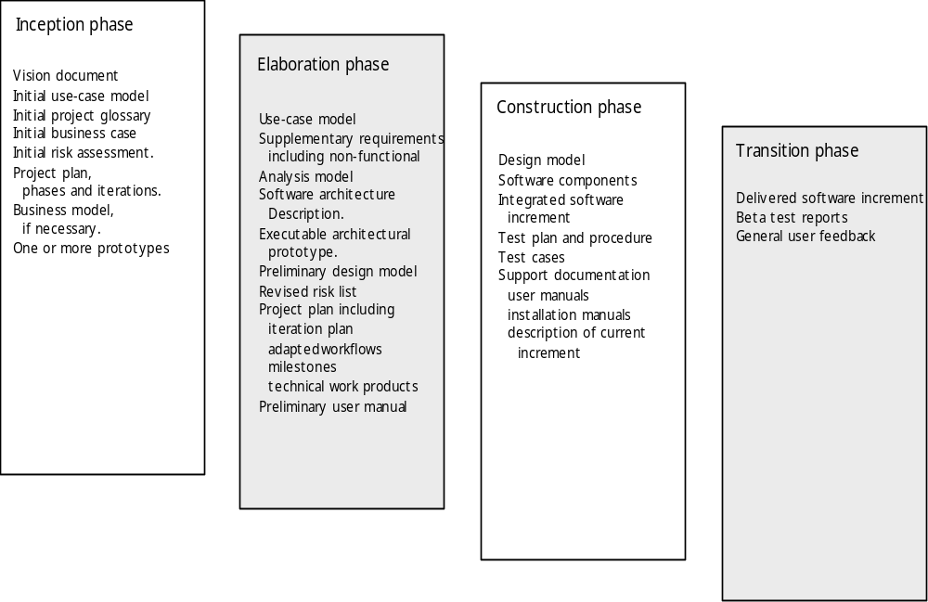
UP Work Products
These slides are designed to accompany Software Engineering: A Practitioner’s Approach, 7/e (McGraw-Hill, 2009). Slides copyright 2009 by Roger Pressman.

